Slide 1
The easiest,
most efficient way to
manage Azure subscriptions
at scale
The easiest, most efficient way to manage Azure subscriptions at scale

Slide 2



Stephane Lapointe
@s_lapointe
The easiest, most efficient way to manage Azure subscriptions at scale
Microsoft Azure MVP
Cloud Solutions Architect

Slide 3
Agenda
• Management at scale in Azure
• What we used to do
• Say hello to Azure Resource Graph
• Query syntax and basics
• ARG in the portal
• ARG outside the portal
• ARG and Azure Policy
• Q&A
The easiest, most efficient way to manage Azure subscriptions at scale

Slide 4
Management at scale in Azure
The easiest, most efficient way to manage Azure subscriptions at scale

Slide 5

Things tend to get messy
The easiest, most efficient way to manage Azure subscriptions at scale

Slide 6






Management groups
Azure policy
Blueprints
The easiest, most efficient way to manage Azure subscriptions at scale
Resource Graph
Cost Management

Slide 7
What we used to do
The easiest, most efficient way to manage Azure subscriptions at scale

Slide 8

One at a time
The easiest, most efficient way to manage Azure subscriptions at scale

Slide 9

Typical script
Lookup for all resources of a specific type
• Get subscription list
• Change context for each subscription
• Query
The easiest, most efficient way to manage Azure subscriptions at scale
$ErrorActionPreference = 'Stop'
$subcriptions = Get-AzSubscription
$results = $subcriptions | ForEach-Object {
$_ | Set-AzContext | Out-Null
Write-Host ('Scanning subscription {0}' -f $_.Name) -ForegroundColor Green
Get-AzResource -ResourceType 'Microsoft.Storage/storageAccounts'
}
#do something with $results
$results

Slide 10
Say hello to Azure Resource Graph
The easiest, most efficient way to manage Azure subscriptions at scale

Slide 11

provide efficient and performant
resource exploration
The easiest, most efficient way to manage Azure subscriptions at scale
ability to query at scale across a given set of subscriptions

Slide 12
Azure
Resource Graph
Features
• Blazing fast
• Visibility across your cloud resources
• Powerful querying to gain deeper insights
• Rich aggregation and parsing of granular properties
• Tracking of changes made to resource properties
• Support Azure Delegated Resource Management (Azure Lighthouse)
The easiest, most efficient way to manage Azure subscriptions at scale

Slide 13
Azure
Resource Graph
Queries are read only
• Subset of the operators and functions of Azure Data Explorer
https://docs.microsoft.com/en-us/azure/governance/resource-graph/concepts/query-language
Refresh frequencies
• ~15 sec at change
• Regular full scan
The easiest, most efficient way to manage Azure subscriptions at scale

Slide 14
Azure
Resource Graph
Restrictions and nice to know
• Not all types are supported
see the schema browser in the portal or
https://docs.microsoft.com/en-ca/azure/azure-resource-manager/complete-mode-deletion
• Need to implement a paging mechanism when you have a large result set or more than 1000 subscriptions
The easiest, most efficient way to manage Azure subscriptions at scale

Slide 15
Query syntax and basics
The easiest, most efficient way to manage Azure subscriptions at scale

Slide 16
Query language is based on the Kusto query language used by Azure Data Explorer.
The easiest, most efficient way to manage Azure subscriptions at scale

Slide 17
Azure
Resource Graph
String operators
https://docs.microsoft.com/en-us/azure/kusto/query/datatypes-string-operators
Operator | Description | Case-Sensitive | Example (yields true)
== | Equals | Yes | "aBc" == "aBc"
!= | Not equals | Yes | "abc" != "ABC"
=~ | Equals | No | "abc" =~ "ABC"
!~ | Not equals | No | "aBc" !~ "xyz"
contains | RHS occurs as a subsequence of LHS | No | "FabriKam" contains "BRik"
matches regex | LHS contains a match for RHS | Yes | "Fabrikam" matches regex "b.*k"
The easiest, most efficient way to manage Azure subscriptions at scale

Slide 18
Azure
Resource Graph
where operator
Filters to the subset of rows that satisfy a predicate.
https://docs.microsoft.com/en-us/azure/kusto/query/whereoperator
The easiest, most efficient way to manage Azure subscriptions at scale
// all web sites
Resources
| where type =~ "Microsoft.Web/sites"
// all resources not global or canada, excluding networkwatchers and Microsoft insights types Resources
| where location !contains 'global' and location !contains 'canada'
| where type !~ 'Microsoft.Network/networkwatchers'
| where type !startswith 'microsoft.insights/'

Slide 19
Azure
Resource Graph
project operator
Select the columns to include, rename or drop, and insert new computed columns.
https://docs.microsoft.com/en-us/azure/kusto/query/projectoperator
The easiest, most efficient way to manage Azure subscriptions at scale
// all web sites, returning only subscriptionId, resourceGroup and name
Resources
| where type =~ "Microsoft.Web/sites"
| project subscriptionId, resourceGroup, name

Slide 20
Azure
Resource Graph
project-away operator
Select what columns in the input to exclude from the output.
https://docs.microsoft.com/en-us/azure/kusto/query/projectawayoperator
The easiest, most efficient way to manage Azure subscriptions at scale
// all web sites returning all information but properties (bag) and managedby
Resources
| where type =~ "Microsoft.Web/sites"
| project-away properties, managedBy

Slide 21
Azure
Resource Graph
extend operator
Create calculated columns and append them to the result set.
https://docs.microsoft.com/en-us/azure/kusto/query/extendoperator
The easiest, most efficient way to manage Azure subscriptions at scale
// all web certificates that expires within 90 days
Resources
| where type =~ "Microsoft.Web/certificates" and properties.expirationDate <= now(90d)
| extend expirationDate = tostring(properties.expirationDate)
| project subscriptionId, resourceGroup, name, location, thumbprint = properties.thumbprint, expirationDate, friendlyName = properties.friendlyName, subjectName = properties.subjectName
| sort by expirationDate asc

Slide 22
Azure
Resource Graph
summarize operator
Produces a table that aggregates the content of the input table.
https://docs.microsoft.com/en-us/azure/kusto/query/summarizeoperator
The easiest, most efficient way to manage Azure subscriptions at scale
// count of all resources by subscription and location
Resources
| summarize count() by subscriptionId, location
// count of storage accounts with HTTP enabled by location
Resources
| where type =~ 'Microsoft.Storage/storageAccounts'
| where properties.supportsHttpsTrafficOnly == 'false'
| summarize count = count() by location

Slide 23
Azure
Resource Graph
Querying over tags
Use tags.name or tags['name'] construct to query tags on resources.
https://docs.microsoft.com/en-us/azure/kusto/query/extendoperator
The easiest, most efficient way to manage Azure subscriptions at scale
// return all resources with the value 'production' in the 'environment' tag
Resources
| where tags['environment'] =~ 'production'
| project subscriptionId, resourceGroup, name, tags
// return all resources where the tag 'environment' is not present
Resources
| where isempty(tags['environment'])
| project subscriptionId, resourceGroup, name, tags

Slide 24
Azure
Resource Graph
Tables
https://docs.microsoft.com/en-us/azure/governance/resource-graph/concepts/query-language#resource-graph-tables
Resource Graph tables | Description
Resources | The default table if none defined in the query. Most Resource Manager resource types and properties are here.
ResourceContainers | Includes subscription (Microsoft.Resources/subscriptions) and resource group (Microsoft.Resources/subscriptions/resourcegroups)
AlertsManagementResources | Includes resources related to Microsoft.AlertsManagement.
SecurityResources | Includes resources related to Microsoft.Security.
The easiest, most efficient way to manage Azure subscriptions at scale

Slide 25
Azure
Resource Graph
Tables
https://docs.microsoft.com/en-us/azure/governance/resource-graph/concepts/query-language#resource-graph-tables
Resource Graph tables | Description
AdvisorResources | Includes resources related to Microsoft.Advisor.
HealthResources | Includes resources related to Microsoft.ResourceHealth.
MaintenanceResources | Includes resources related to Microsoft.Maintenance.
The easiest, most efficient way to manage Azure subscriptions at scale

Slide 26
Azure
Resource Graph
Join operator
https://docs.microsoft.com/en-us/azure/kusto/query/joinoperator
hint: you can use kind = JoinType kind = inner | kind = leftouter etc.
The easiest, most efficient way to manage Azure subscriptions at scale
// 1 random result joining ResourceContainers table to include subscriptionName to result set
Resources
| join kind = leftouter (ResourceContainers | where type=~'Microsoft.Resources/Subscriptions' | project subscriptionName=name, subscriptionId) on subscriptionId
| project type, name, subscriptionId, subscriptionName
| limit 1

Slide 27
Demo: ARG in the portal
The easiest, most efficient way to manage Azure subscriptions at scale

Slide 28
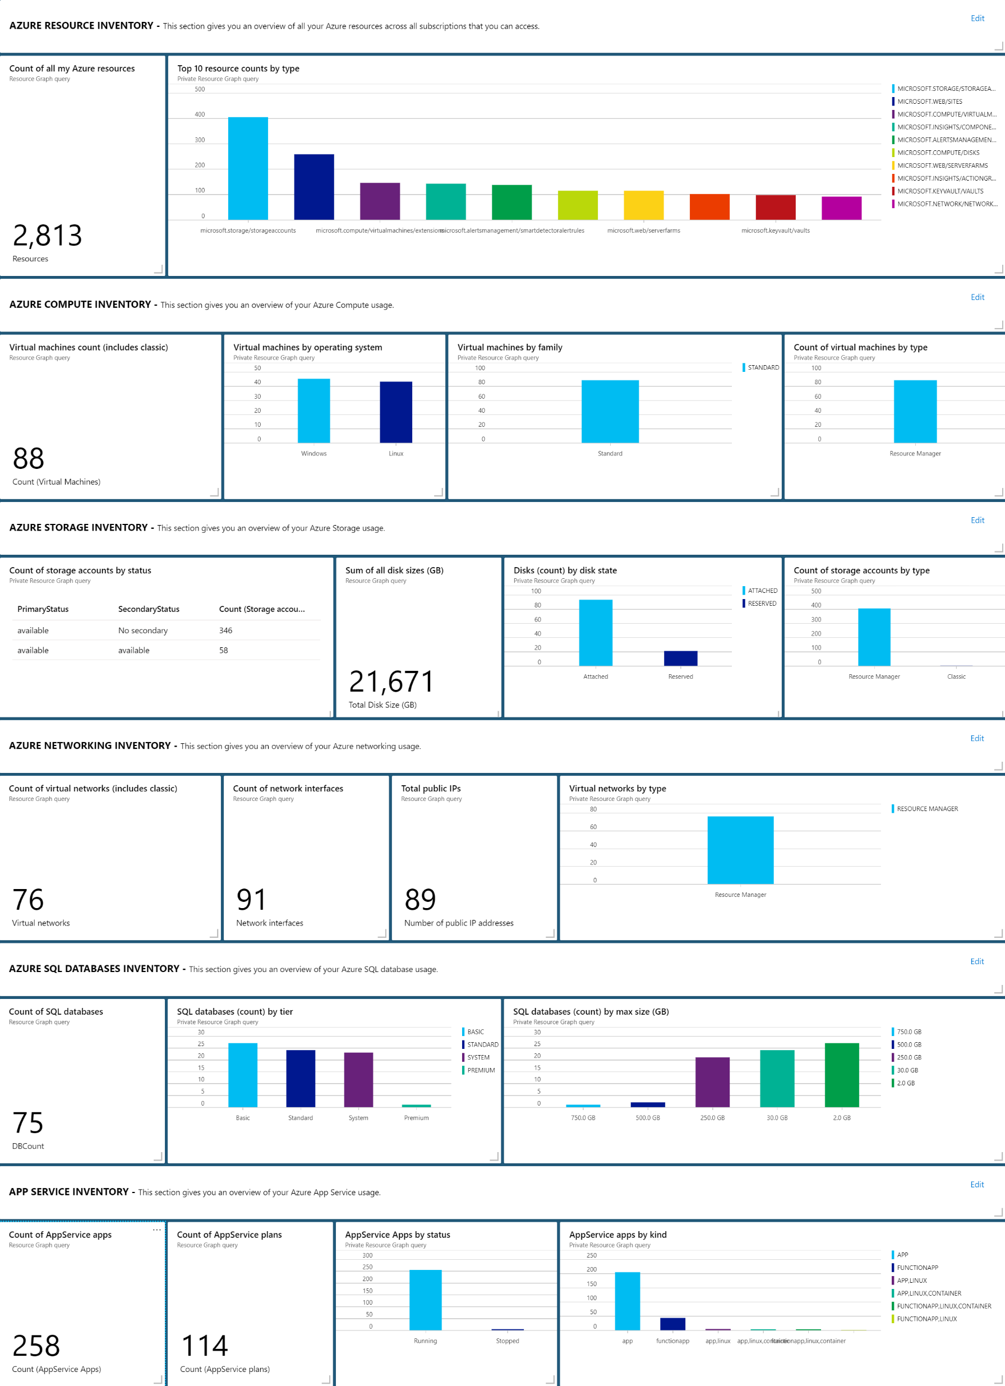

Slide 30
ARG outside the portal
The easiest, most efficient way to manage Azure subscriptions at scale

Slide 31
PowerShell
How to use Azure Resource Graph in PowerShell
• Install Az modules
• Install Az.ResourceGraph module
• Use Search-AzGraph cmdlet
The easiest, most efficient way to manage Azure subscriptions at scale
$pageSize = 100
$iteration = 0
$searchParams = @{
Query = 'where type =~ "Microsoft.Network/applicationGateways" | project id, subscriptionId, subscriptionDisplayName, resourceGroup, name, sslCertificates = properties.sslCertificates | order by id'
First = $pageSize
Include = 'displayNames'
}
$results = do {
$iteration += 1
Write-Verbose "Iteration #$iteration"
$pageResults = Search-AzGraph @searchParams
$searchParams.Skip += $pageResults.Count
$pageResults
Write-Verbose $pageResults.Count
} while ($pageResults.Count -eq $pageSize)

Slide 32

Azure CLI
How to use Azure Resource Graph in Azure CLI
• Install Azure CLI
• Install resource-graph extension
• Use az graph query
The easiest, most efficient way to manage Azure subscriptions at scale
// Request a subset of results, skipping 20 items and getting the next 10. az graph query -q "where type =~ "Microsoft.Compute" | project name, tags" --first 10 --skip 20 // Choose subscriptions to query. az graph query -q "where type =~ "Microsoft.Compute" | project name, tags" –subscriptions 11111111-1111-1111-1111-111111111111, 22222222-2222-2222-2222-222222222222

Slide 33
ARG and Azure Policy
The easiest, most efficient way to manage Azure subscriptions at scale

Slide 34
Azure Policy
Aliases
How to return Azure Policy aliases
The aliases array isn't provided by default in the results of a query
https://docs.microsoft.com/en-us/azure/governance/resource-graph/samples/starter#show-aliases
The easiest, most efficient way to manage Azure subscriptions at scale
Resources
| where type =~ 'Microsoft.Compute/virtualMachines'
| limit 1
| project aliases

Slide 35
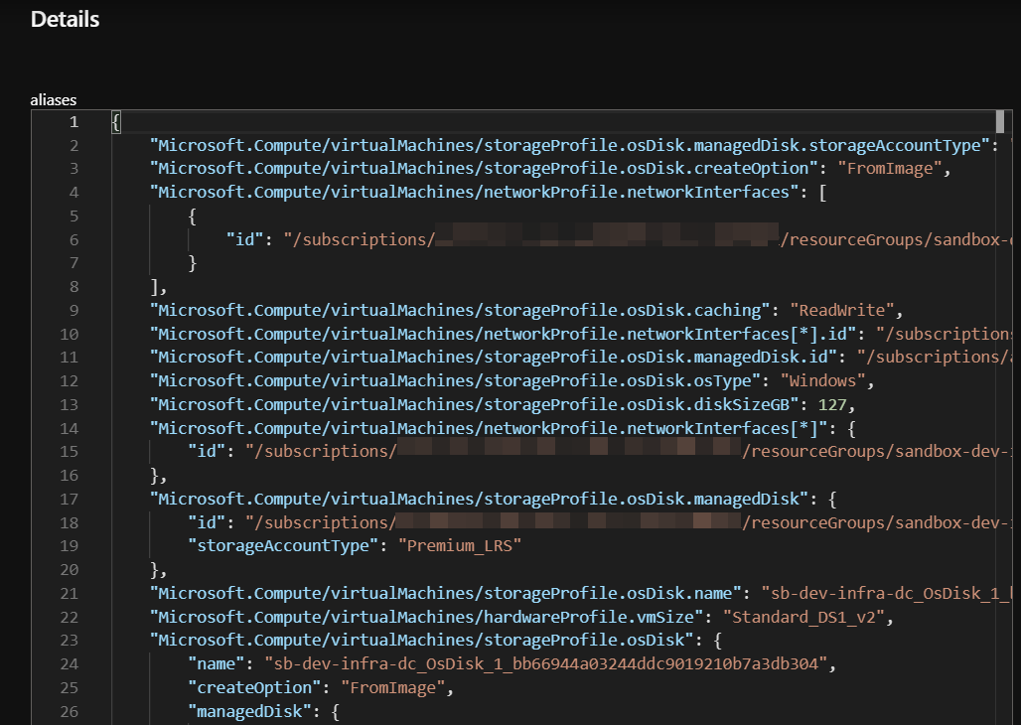
Azure Policy
Aliases
Output example
The easiest, most efficient way to manage Azure subscriptions at scale

Slide 36
graph2policy
Convert simple graph query to Azure policy
This tool converts an Azure Resource Graph query into a policy rule
https://github.com/slapointe/ConvertToPolicy
The easiest, most efficient way to manage Azure subscriptions at scale
graph2policy -q "where type =~ 'microsoft.compute/virtualmachines' and isempty(aliases['Microsoft.Compute/virtualMachines/storageProfile.osDisk.managedDisk.id'])" --effect "audit" --create "AuditNonManagedDiskVMPolicy"

Slide 37

Resources
Azure Resource Graph documentation
Azure Resource Graph quickstart queries
Azure Policy
Azure Policy Aliases
Azure Governance
Azure CLI
Azure PowerShell
graph2policy
Resource Graph Azure Dasboards
The easiest, most efficient way to manage Azure subscriptions at scale

Slide 38


Questions?
use Q&A
After
@s_lapointe
The easiest, most efficient way to manage Azure subscriptions at scale

